Slide 1
Transformed UK Athena Swan Charter: Presentation to London Mathematical Society
November 30 2021
#AthenaSwan
Notes:
Thank you for inviting Advance HE to make this presentation today, introducing the key changes with the Transformed Athena Swan Charter, as part of the LMS Good Practise Sharing series. I know that many of you have been actively involved in promoting gender equality in Mathematics and allied disciplines for some time, and that this society and these events have played a key role in that.
Today I am going to briefly introduce the key changes with the launch of the Transformed Charter and highlight the main differences to consider as you are thinking about future AS applications. You’ll notice little orange boxes appearing in the bottom right hand corner of some slides, which emphasise key changes for departments.
Please feel free to post any immediate questions you have in the chat and my colleague Rachel will respond to any she can directly, and help me be sharing questions at the end. You can also ask questions directly at the end of the presentation if you prefer.

Slide 2

Transformed Charter
Paradigm shift from prescription to autonomy and flexibility;
Reduction in administrative burden;
AHE moving from a judging to developmental and supporting approach.
Photo by Ross Findon on Unsplash
Notes:
Following feedback from members, Advance HE commissioned an independent review of the Charter, involving significant consultation with the sector, which was published in March 2020. Based on the review recommendations, Advance HE undertook a transformation project overseen by the Athena Swan Governance Committee, that brought together experts from across the sector with experience leading gender equality work. New charter framework and materials were published on 30 June of this year, including revised principles, criteria, application forms and assessment processes.
The transformed charter intends to create:
Paradigm shift from prescription to autonomy and flexibility;
Reduction in administrative burden, including a halving of mandatory data;
AHE moving from a judging to developmental and supporting approach.
We will talk about what this means in practice in the next sections.

Slide 3
The Athena Swan process
Evaluate progress and success
Self-assessment
Participant’s efforts are recognised and rewarded through Athena Swan awards – Bronze, Silver and Gold
Action plan
Identify priority issues and solutions
Notes:
There are some significant changes. However, it’s important to stress that the fundamental process that underpins Athena Swan has not changed.
The Charter framework is still based on a cycle of evaluating gender equality in your particular context and developing actions to address the issues identified, then evaluating the progress and success of these actions, and revisiting your analysis of the context to ensure you’re identifying where things are working well and building on previous progress.
CLICK As before, efforts to progress gender equality are recognised through Athena Swan awards – Bronze, Silver and Gold – at both departmental and institutional levels.

Slide 4
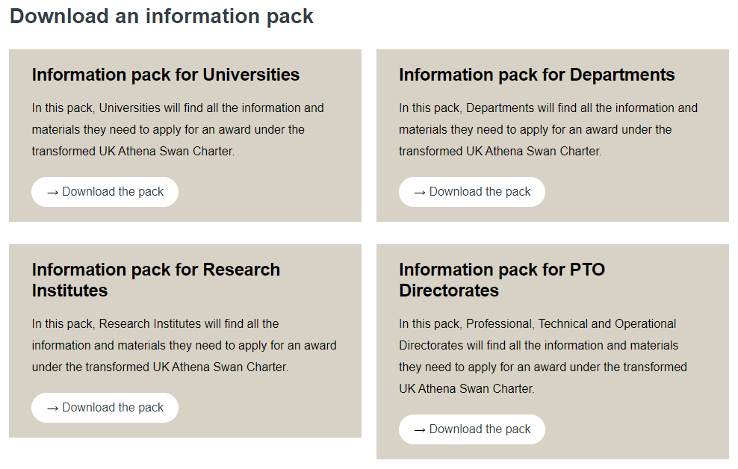
Key changes in the new framework
The Charter Principles
Award criteria
Application materials
Data requirements
Application and
assessment processes
https://www.advance-he.ac.uk/equality-charters/transformed-uk-athena-swan-charter#download
Notes:
The new framework includes revised Charter principles, award criteria, application forms and data requirements. There are also some changes to the application and assessment processes. I’m going to spend the next 20 minutes or so giving you an overview of each aspect of the new framework – further detail on all of them can be found on our website. You can download applicant information packs on our website, which includes all the key information that you need to apply under a given route.
Just to note that there is now a specific application route for professional, technical and operational (PTO) Directorates (eg Library or IT services) under the new Charter. Academic departments should continue to include PTO staff within their department in their applications.

Slide 5
Charter Principles

Slide 6
Charter Principles
Shared goals for gender equality
Positive statements that Charter participants demonstrate their support for
Highlights commitment to gender equality to their staff, students and community
Key change for departments: All units applying for awards must now commit to the Principles
Link to template for Head of Department /Institution letter.

Slide 7
Principles: key changes
Approach to gender equality work
Negative cultures and behaviours
Intersectional and structural inequalities
Inclusive of all gender identities
Caring responsibilities
Notes:
More active and accountable in relation to participants’ approach to gender equality, including specific commitment that gender equality work must be distributed appropriately, recognised and rewarded.
Specifically mentions negative cultures and behaviours that must be tackled, for example gender based violence, bullying and harassment.
More active commitment in relation to intersectional inequalities and structural inequalities.
Confirming the Charter as inclusive of all gender identities.
Specifically mentions mitigating the negative and gendered impacts of caring responsibilities, a key underpinning structural barriers which has been further highlighted by impacts of Covid.

Slide 8
Award Criteria

Slide 9
Criteria: key changes
More concise and clearer
Priorities
Impact → Success
Beacon → sector-leading & supporting others
Transparent expectations
Renewal criteria condensed
Notes:
In general these criteria will look familiar to many of you because they are very close to the existing award criteria for Bronze, Silver and Gold awards and are still designed to reflect effective progression of gender equality using the process discussed earlier. The biggest change is that we have now developed the expectations underpinning these criteria and some of these are different to previous framework.
They have been made more concise and clearer – which will be easier than interpreting a paragraph of narrative for both applicants and reviewers.
Priorities start to be mentioned – this is a key change to the transformed Charter which will allow applicants to focus on what is important for them.
You might also spot the absence of some familiar terms – we have moved away from using the term ‘impact’ instead talking about ‘success’ to be clear about what we mean, especially given the number of different uses of the term impact across our sector.
Similarly we have clarified the gold criteria – where we once talked about ‘beacon’ activity, we now clearly describe this through the two aspects of sector-leading activity, and supporting others to improve.
The criteria for renewals are slightly different – these have been condensed into fewer criteria points, and the institutional criterion relating to embedding AS across the institution is no longer a specific criterion.

Slide 10
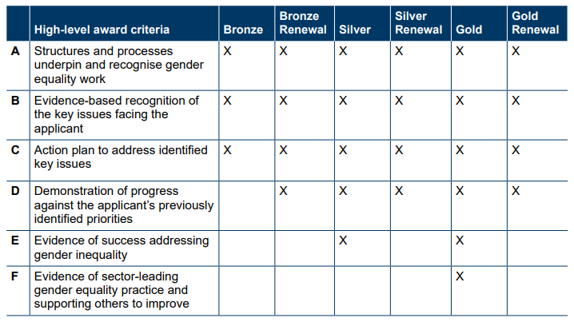
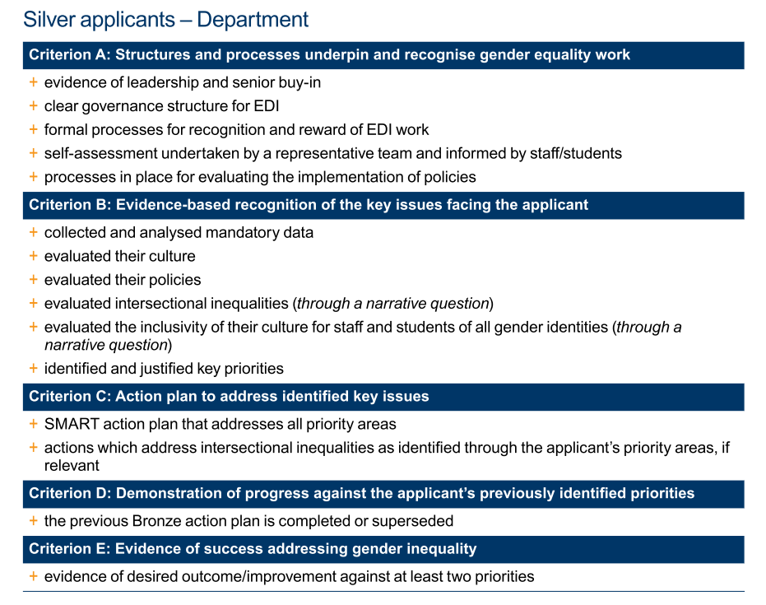
Award Criteria
…and underpinning expectations
Now there are two elements:
high-level award criteria…
Notes:
there are now two elements: the award Criteria (CLICK) which outline the high-level requirements at each level and (CLICK) the expectations which underpin these at each award level. Further details can be found in the guidance in the application packs. We will cover some of the expectations in more detail below.

Slide 11
Silver
Progress against priorities (D)
Evidence of Success (E)
Bronze
Identification of key issues (B)
Action plan (C)
Structures to recognise gender equality work (A)
Sector-leading (F)
Supporting others (F)
Gold
Notes:
This hopefully looks familiar, with the higher level award criteria building on the lower ones.
Bronze
Structures and process underpin and recognise gender equality work
Evidence-based recognition of the key issues facing the applicant
Action plan to address identified key issues
Silver
Bronze Criteria plus…
D - Demonstration of progress against the applicant’s previously identified priorities
E - Evidence of success addressing gender inequality
Gold
Silver, Bronze Criteria plus…
F - Evidence of sector-leading gender equality practice and supporting others to improve

Slide 12
Silver
Evidence against two priorities
Positive impact of policies (university only)
Gold
Evidence against three priorities
Longitudinal improvement
Sector-leading & supporting others
Positive impact of policies (university only)
Notes:
Two elements worth pulling out relate to applicants at higher levels. To meet the criteria, applicants are now expected to provide evidence of how they have achieved the desired outcome against two priorities for a Silver award, three for Gold.
At university level, applicants must show that policies are considered to be effective and appropriate by staff/students, and/or, provide evidence of the positive impact of policies on staff/students.
At Gold level, applicants are expected to demonstrate evidence of longitudinal improvement, over the course of more than one award cycle, and as mentioned previously, applicants are asked to show how they are both sector-leading in their approach to their policies and practice, and how they support others to improve.

Slide 13
New details
Governance, recognition and reward of EDI work
Policy development and evaluation
Greater focus on culture, inc all genders
Narrative consideration of intersectionality – required of all applicants
← Key change for departments
Notes:
New details captured within the expectations include:
In line with our strengthened Principle in this area, a requirement to evidence your governance structure for EDI work, and how work is recognised and rewarded.
Requirement to outline what processes you have in place (or actions if you don’t have any) to develop policies and evaluate them for gendered issues. Departments need only mention development of department-level policies, not institutional ones which we recognise are outwith their remit. Or if departments do not have their own policies, discuss how they communicate, implement university policies, for example and any feedback on these [example]
While we have always had a focus in the application on culture, this is now strengthened and made central through the expectations. This includes considering how inclusive your culture is for people of all gender identities.
In a key change for departments, applicants at all levels must now consider intersectional inequalities through a narrative-based question. You should note that no intersectional data is required of departmental applicants – I’ll talk more about data requirements later.
In terms of what intersection to consider, applicants can choose to focus on the intersection of gender with any other characteristic; this prioritisation should be evidence-based, informed by your own specific context and/or regional or national data and trends.

Slide 14
Inclusivity of all gender identities: Applicant expectations
Evaluated the inclusivity of their culture for staff and students of all gender identities (through a narrative question)
Applicants should consider the ways in which they actively strive (or could in future, through action) for the inclusion of people of all gender identities. The provision of quantitative data is not required. Applicants should not be deterred if the university’s demographic data indicate low rates of disclosure from eg trans or non-binary people, and are encouraged to consider how to embed inclusive practices and approaches within culture and activity.
Notes:
In the Transformed Charter, there is an expectation that applicants evaluate the inclusivity of their culture for staff and students of all gender identities.
This is expected through a narrative question in the application form which asks applicants to consider ways in which they actively strive (or could in future, through action) for the inclusion of people of all gender identities. The provision of quantitative data is not required.
For most departments, analysing culture survey results will be the key evidence base for evaluating the inclusivity of their culture, as we will discuss shortly. However, some departments may not have many or any disclosures from trans and non-binary staff so you may not be able to evaluate the inclusivity of your culture for trans and non-binary staff through the culture survey. Where you have some openly trans or non-binary staff or students, or representatives from relevant networks who are willing to undertake interviews or focus groups, you could choose to evaluate the inclusivity of your culture in that way.
In gathering data from staff and students you may find some reluctance particularly where information is sensitive or individuals may be identifiable. You should consider how to manage your data in a way that increases trust and encourages disclosure. For example, using external facilitators to conduct interviews or focus groups so that feedback can be collated and reported without attributing to any individual. Or for quantitative data, you can limit sensitive data analysis to smaller groups such as a subgroup of your self-assessment team so that information is not shared with everyone.
You should also communicate with staff and students your commitment to gender equality issues, emphasising that information will be used to drive improvements. As mentioned previously, communicate the confidentiality of your data, including who will have access to it and to what extent it will be anonymous.

Slide 15
Intersectionality: Applicant expectations
Bronze
Evaluated their approach to exploring intersectional inequalities (through a narrative question)
Silver and Gold
Evaluated intersectional inequalities (through a narrative question)
Actions which will enable the applicant to evaluate intersectional inequalities in the future
Actions which address intersectional inequalities as identified through the applicant’s priority areas, if relevant
Universities and RIs: Give due regard to intersectionality wherever possible in data analysis
Notes:
In practice, what is expected of Athena Swan applicants on intersectional inequalities under the transformed charter varies depending on what level of award you are applying for.
Bronze applicants are expected to evaluate their approach to exploring intersectional inequalities through a narrative question, and then to include actions in your action plan that will enable you to evaluate intersectional inequalities in the future.
So for Bronze applicants, it is sufficient to reflect on your capacity to identify and address intersectional inequalities for staff and students, and if existing infrastructures and evidence-bases do not support the evaluation of intersectional inequalities, develop actions to address this. For example, putting data collection (if appropriate) or consultation processes in place.
Silver and Gold applicants are expected to already have the ability to evaluate intersectional inequalities and so are expected to include their current understanding of intersectional inequalities in their application and address the inequalities identified through their priorities and action plan.
In order to evaluate intersectional inequalities, you could
choose to analyse existing data sets, such as the mandatory quantitative data sets or the culture survey, with an intersectional lens.
You could also build an intersectional analysis into any consultation you have planned with staff.
Some applicants have asked what we mean by ‘through a narrative question’ – this means that this expectation is not expected to be addressed through the mandatory data sets and that applicants should consider the question guidance in the application forms.

Slide 16
Application Materials

Slide 17
Application forms: key changes
Aligned with criteria
Flexibility
Shorter forms
Priorities
Appendices
Notes:
The application forms are one of the areas we’ve made the most change. The key structural differences to the forms are outlined here.
Firstly, sections are clearly aligned with criteria, with the questions and guidance structured to help applicants evidence against the expectations.

Slide 18
New structure | Criterion
An overview of the uni / dept / directorate and its approach to gender equality | A - structures and processes are in place to underpin and recognise gender equality work
An assessment of the uni / dept / directorate’s gender equality context | B - evidence-based recognition has been demonstrated of the key issues facing the applicant
Future action plan | C - an action plan is in place to address identified key issues
An evaluation of the uni / dept / directorate’s progress and success (Silver and Gold) | D - progress against the applicant’s previously identified priorities has been demonstrated E - success in addressing gender inequality has been evidenced
An evaluation of the uni / dept / directorate’s sector-leading activity (Gold) | F - evidence of sector-leading gender equality practice and supporting others to improve
Notes:
So for example here, you can see that each section of the form maps onto a particular criterion

Slide 19
Application forms
Aligned with criteria
Aligned with criteria
Flexibility
Flexibility
Shorter forms
Shorter forms
Priorities
Priorities
Appendices
Appendices
Notes:
In addition to aligning criteria with form, a core objective was embedding the flexibility so that applicants can focus on what is relevant and important in their context. For that reason, questions are broader, prompting applicants to think about their culture, systems and practices rather than asking issue-specific questions as we have in the past.
Forms are shorter – the idea is to build trust in both applicants, to approach the charter meaningfully and genuinely, and in reviewers to give all applicants a fair assessment - so applicants should not feel the need to include everything. It’s about quality of self-assessment and analysis rather than quantity. Add on word count.
Priorities - applicants are asked to identify between 4-8 key priorities. These should be based on their evidence and should be key areas where progress will make a meaningful difference. Don't be tempted by the low hanging fruit, remember why you’re doing this - to make a difference!! Panels will expect to see evidence for why you have chosen those priorities and understand that some intractable issues take time to address.
Appendices –applicants are now asked to present data in an appendix. This is to keep the focus on the analysis, make it easier for applicants to edit their application later avoiding data sharing challenges when publishing, and prepare the way for future online applications and data management

Slide 20
Data requirements

Slide 21
Mandatory data requirements
Significantly reduced
Department data requirements
Students at foundation, UG, PGT, PGR
Degree attainment & completion rates
Academic staff by contract function
Academic staff by contract type
PTO staff by job family
PTO staff by contract type
Academic applications, shortlist & appointments
PTO applications, shortlist & appointments
Applications & success rates for academic promotion
Applications & success rates for PTO progression
University data requirements
Students at foundation, UG, PGT, PGR
Academic staff by contract function
Academic staff by contract type
PTO staff by job family
PTO staff by contract type
Academic applications, shortlist & appointments
PTO applications, shortlist & appointments
Applications & success rates for academic promotion
Applications & success rates for PTO progression.
Notes:
Following the spirit of streamlining and offering flexibility, the new mandatory data requirements represent a significantly reduced approach compared to the existing Athena Swan requirements.
Where in the past applicants have been required to provide data across a broad range of areas including:
Turnover data for leavers;
Induction uptake;
REF return data;
Training and appraisal uptake;
Appraisal uptake;
parental leave uptake;
Committee membership;
We now focus on a significantly reduced set of critical data, nine categories for universities, ten for departments, four for PTO directorates.
The mandatory datasets are the minimum that applicants are required to present. Applicants can choose to include other data that is relevant to their priority areas.
What the new framework offers is flexibility for the applicant to identify what they need for their context and priorities so while additional data may be included, the intention is that this entirely supports the applicant’s gender equality objectives, as opposed to requiring potentially irrelevant or less useful data from everyone.
One of data requirements that will be new for some departments is the inclusion of Professional Technical and Operational staff by job family, contract type and related to PTO staff progression. This data is only required where PTO staff are line managed within the department and has been included as part of the transformed charter’s commitment to recognising all roles within our institutions. Similarly to the data around academic staff, these data sets are designed to enable you to identify if particular genders are under or over-represented at particular grades, contract types or job families.

Slide 22
Data: things to note
Years of data: 3 years for first-time Bronze.
Renewal, Silver and Gold applications present data covering the period since the previous application (usually 5 years).
Previous academic year expected by May and July rounds.
New for some departments is inclusion of PTO staff by job family, contract type and PTO staff progression.
Intersectional data not required at departmental level
Notes:
The years of data required has also changed.
In first-time Bronze applications, 3 years of data should be presented where possible (and where this is not possible, an explanation should be provided). In Bronze renewal, Silver and Gold applications, data should be presented covering the period since the previous application (which for most applicants will mean 5 years of data). Data for earlier periods can be included if desired; for example, to demonstrate longitudinal improvement in Gold applications.
Panels expect to see the most recent data you have access to while also recognising that self-assessment teams need time to analyse and reflect on data. So submissions in May & July are expected to include data from the previous academic year whereas applications submitted earlier in the academic year are not.
At silver and gold university level: To support the university’s intersectional analysis, applicants should give due regard to intersectionality wherever possible in their data presentation. Departments should note this is only required of universities, no intersectional data is mandated of departments, though of course if you have data available and wish to include it you can.
And, for applications from universities or faculties, data should be disaggregated by sub-unit. For faculties this is most likely to be by department, for universities, this should be whatever unit that is most helpful for their gender equality analysis and objectives, this for example, could be by faculty or department.

Slide 23
Culture survey
Options for depts: run full survey (28 Qs) or embed 7 core Qs into existing survey
Mandatory for departments
Timing: ideally no more than 1y prior to app
Survey themes
Bullying and harassment
Gender equality
Work-life balance
Wellbeing
Career development
Belonging and inclusion
Note: Use of survey expected of all departmental applicants from Jan 2023 round onwards
Notes:
The importance of local culture came across strongly from the independent review’s consultation with the sector. The transformation gave us an opportunity to strengthen the focus on culture and make it central to the process. To help applicants, and establish a consistent approach across all participants, we have created a survey for use by departmental applicants so that they may explore and assess their culture, covering themes of Belonging and Inclusion, Gender Equality, Work-Life Balance, Bullying and Harassment, Career Development, and Well-being.
The departmental culture survey is a new introduction to the Athena Swan Charter. To ensure it is as effective and supportive of applicants’ gender equality work as possible, Advance HE will review with the Athena Swan Governance Committee its use by early adopters during 2021 and 2022.
Obviously, we’re aware that universities and departments may already have culture assessment surveys so to support flexibility, departmental applicants have a choice of running the full culture survey, or embedding the seven ‘core’ questions into existing surveys. As a minimum, the results of the core questions must be included in departmental applications under Appendix 1.
Universities are not required to run the culture survey for institutional applications.
However, in some cases, a university may wish to run a single survey exercise covering all units within the institution and provide the results of this survey to departments to inform their departmental Athena Swan application. If you wish to do this, please fee free, but remember that departmental applicants will be expected, as a minimum, to present the results of the core survey questions relevant to their context; i.e. they must have access to survey findings disaggregated for their department. Departments will also need to make sure that disaggregated survey results are recent enough to inform their self-assessment effectively – ideally the survey should be run no more than a year prior to a department’s application submission date.
(For institutions that run regular e.g. biennial staff surveys, there may be flexibility here)

Slide 24
The Culture Survey – Additional Questions
As a minimum, ask respondents:
  a question about their gender to allow a gender-specific analysis
  a question about their role in the department (eg academic, PTO staff) to enable analysis by job family or career type.
Advance HE guidance on complying with GDPR
Notes:
Departments will need to ask additional demographic questions to enable you to effectively analyse the results of the survey and identify gender biases in the responses.
As a minimum, applicants are required to ask respondents a question about their gender to allow a gender-specific analysis; and, a question about respondents’ role in the department (eg academic or PTO staff) to enable analysis by job family or career type. You may want to include other demographic questions to enable you to further interrogate your data.
Data protection:
When collecting and analysing data, it's important to treat it sensitively and work in line with data protection regulations and take advice from your local data protection officer or team. This will protect your staff and students’ confidentiality and ensure you comply with the law. GDPR applies to personal data that is identifiable. Advance HE has produced an FAQ on complying with GDPR that you can find on our website (see link on slide). When you are working with small numbers or multiple characteristics, someone may become identifiable even if names are not used. In these cases, you may want to consider asking your SAT to sign non-disclosure or confidentiality agreements or using rounding strategies like the one used by HESA to ensure anonymity.

Slide 25
Transformed application and assessment processes

Slide 26
Application and review
New submission deadlines:
6 across year
Deadline normally last working day
New portal under development, for now upload pdf online
March
May
July
September
November
January
Next submission deadline: 14 January 2022
Notes:
From 2022, Advance HE are making some changes to the way that applicants are asked to submit applications and how they’ll be reviewed.
Firstly, Advance HE are introducing more frequent submission deadlines.
You’ll now have an opportunity to submit on the last working day every other month (the months that are on the slide).
This is designed to give you more flexibility about when you apply.
Holding more frequent assessment rounds in which fewer applications are assessed will also enable Advance HE to provide you with your results and feedback more quickly so you can move forward with your action plans in confidence.
The next submission round is 14 January 2022 – this has given a one month extension to those due to submit in November 2021 due to Covid. That will be the only deadline in Jan 2022 and then deadlines from that point on will fall on the last working day of the month.
Another change that you will see in 2022, is the introduction of a new submission portal
Initially you will be asked to upload your as a pdf application to a portal – the main benefit being that you can see what you’ve submitted
this also will speed up the distribution of applications to peer reviewers
Over the course of the transition period, Advance HE plan to develop this portal so that it makes the process of compiling and submitting the application easier.

Slide 27
Transition period
Transition period: until Nov 2022 round (inclusive)
During this time, both the Post-May 2015 materials and transformed materials can be used

Slide 28
Panel processes
1
Poor
3 Satisfactory
4
Good
2
Narrowly missed
New panel roles and ToR
Reviewers score each criterion
Minor revision: resubmit within 8 weeks
Major revision: resubmit within 6 months
Result within 10 days of panel, feedback
within 12 weeks of submission.
View our Chairs and Reviewers here: https://www.advance-he.ac.uk/equality-charters/athena-swan-charter/transformation/transformed-athena-swan-uk-panel
Notes:
As before, Athena Swan applications will be assessed through a process of peer review. In the context of Athena Swan, Peer review means that applications are assessed by academics or professional and operational staff who are leading gender equality work in their own institutions (i.e. they are peers). We use peer review to maintain the standards of our awards, and to develop and provide credibility to applicant’s gender equality work. Peer review panels have three key responsibilities:
- Review Athena Swan applications
- Agree award outcomes
Provide feedback to applicants
As part of the Transformed Charter, Advance HE are also using new panel processes that are designed to improve the consistency and transparency of the peer review processes, and to provide applicants with developmental feedback sooner. Panels have been newly recruited and trained and you can find panel terms of reference and details of current Chairs and Reviewers on the Advance HE website. We will also be recruiting for new panellists shortly.
Lead reviewers undertake an independent assessment of your application in advance of the panel meeting, assessing it against the published Athena Swan criteria and recommending scores from ‘Poor’ to ‘Good’ for each criterion. The panel discuss the application and independent assessments and finalise scores against each criterion, an outcome for the application and key feedback points.
If you score below ‘Satisfactory’ for any criterion, you will be invited to address the panel’s feedback through a revisions process. This means that no application will be unsuccessful without being offered the opportunity to revise the application and address the panel's feedback.
Minor revisions will enable unsuccessful applicants who have only narrowly missed the criteria (on three or fewer criteria) to revise the application within eight weeks and return for approval by Chair's action.
If an application requires more significant improvement, major revisions will enable applicants to revise and resubmit within six months for assessment by the same panel.
You will receive the outcome of your award within ten working days of the panel meeting – right now, this will be within twelve weeks of your application being submitted and Advance HE hope to shorten this turnaround time as more applicants begin to use the new processes.

Slide 29
Find out more
Detailed applicant packs
Principles commitment letter
Developmental
guidance
Advance HE
website
Advance HE
Website
FAQs
Blogs and interviews
Dissemination
event
registration
Pilot scheme registration
https://www.advance-he.ac.uk/equality-charters/transformed-uk-athena-swan-charter

Slide 30

Get in touch
Contact the Charters Team: athena.swan@advance-he.ac.uk
Athena Swan Network on Advance HE Connect

