Slide 1
Finding your initiative in LGBTQ+ inclusion in Mathematics
Tyler Kelly [they/he]
Professor of Pure Mathematics
Queen Mary University of London
LMS CWDM
REF 2029 PDAP

Slide 2
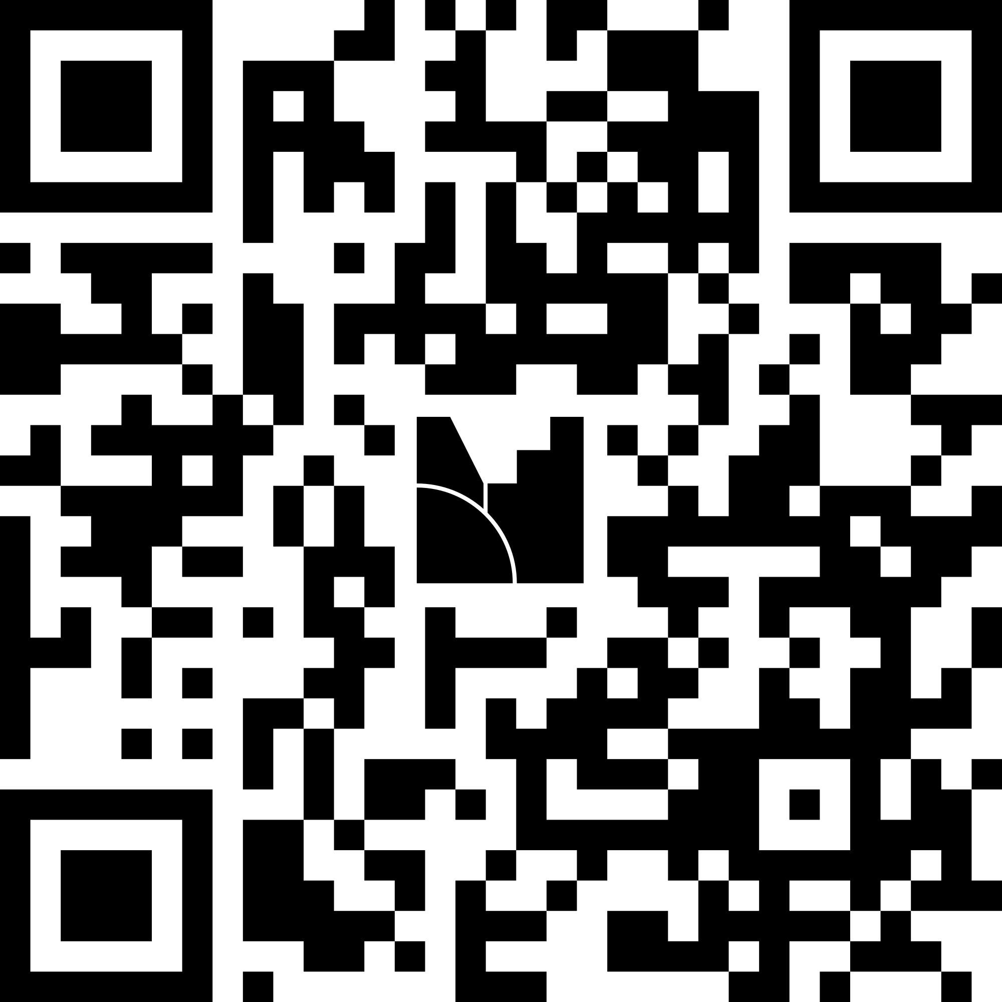
What is Allyship?
Allyship is the active support and advocacy for the equality, rights, dignity and inclusion of LGBTQ+ people. An ally is someone who performs actions to support LGBTQ+ people, without the expectation of getting something back in return.
It is action-focused. It is not wearing a rainbow lanyard after taking a training to understand struggles of LGBTQ+ people. Requires:
Listening – Prioritising LGBTQ+ voices and centering on their needs
Advocacy – Identifying and executing on initiatives to strive for equality
Continuing Development – Accepting feedback and improving

Slide 3

N ~ 25k, N_{lgbtq} ~ 1k
less likely than their non-LGBTQ peers to have adequate career resources and opportunities for career advancement and are less likely to feel comfortable whistleblowing
more likely to have experienced devaluation of their professional expertise
more likely to report social exclusion by their workplace colleagues
more likely to plan to leave their current STEM jobs and to intend to leave STEM entirely (controlling for other factors), and these differences are partly mediated by LGBTQ respondents’ greater likelihood of encountering career limitations, professional devaluation, and social exclusion.

Slide 4

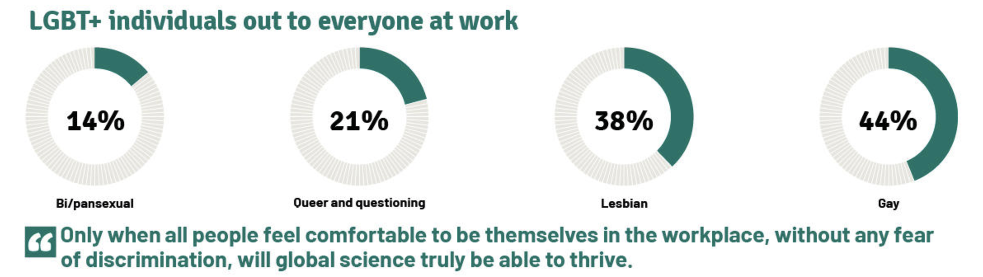
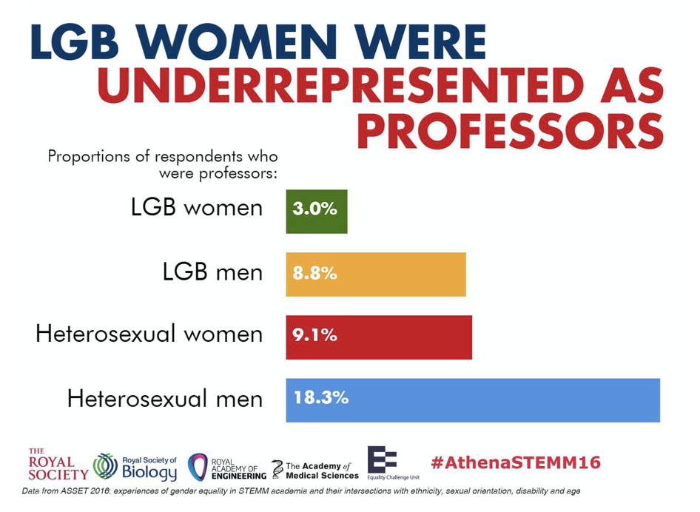
A few more British Surveys:
28% of LGBTQ+ scientists in physics, chemistry and astronomy considered leaving their jobs because of discrimination at work

Slide 5
Goal of today
This workshop aims to identify ideas for work and initiatives to support LGBTQ+ mathematicians.
We will first outline basics quickly. These are well documented and prerequisite material for someone working in EDI.
I assume the terms nonbinary, trans, queer, etc. and standard struggles to be well-known.

Slide 6


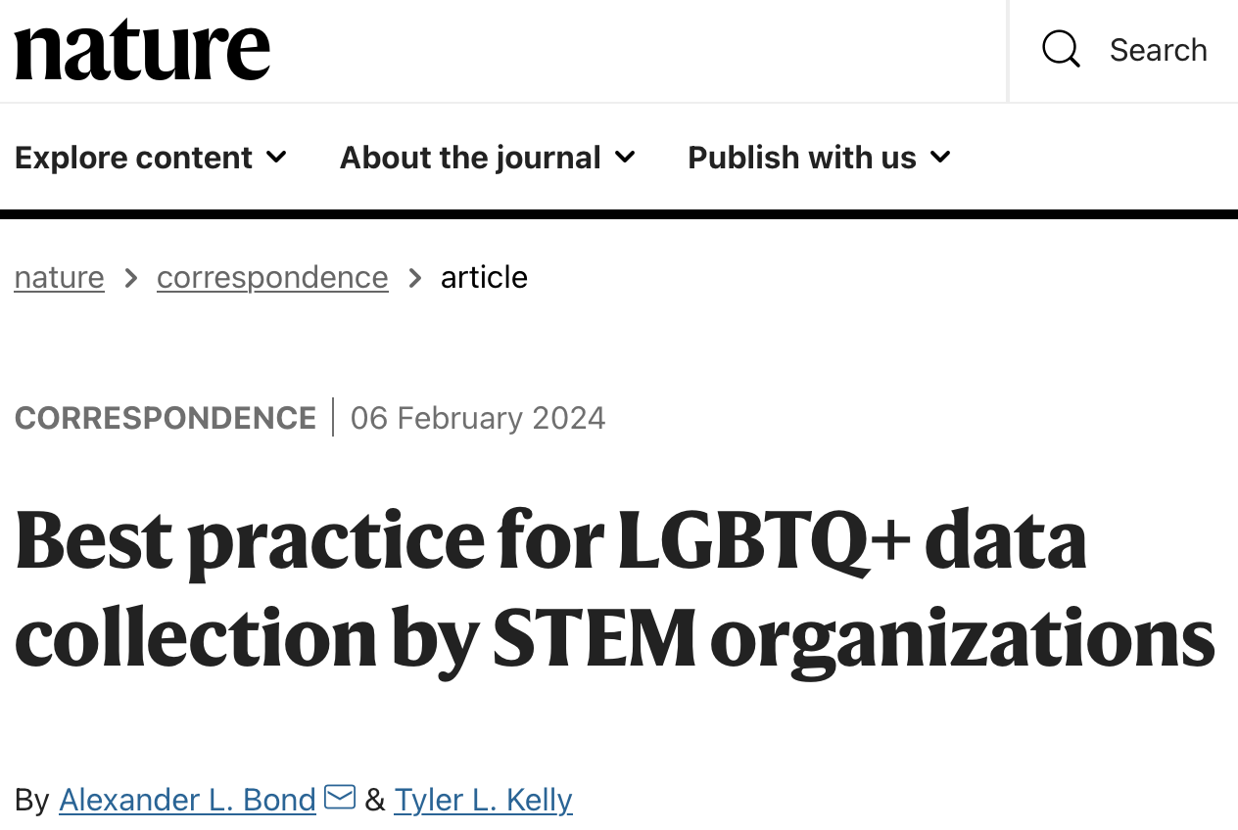
Resources for the basics.
- Advice on Creating a Positive Environment at Events
- Advice on Diversity at Conferences and Seminars
Arxiv:1804.08406

Slide 7
Standard Actions
Platform LGBTQ+ people in research conferences through invited / plenary talks
Hire LGBTQ+ people in research
Safeguard LGBTQ+ people in all contexts
Allow diverse life experiences for researchers / postgrads
Promote a safe LGBTQ+ experience in the workplace
Gender Neutral Bathrooms
Acknowledge and reward (emotional) work of LGBTQ+ people
Provide separate housing in conferences for LGBTQ+ people
All editors should force their publishers to allow name changes for trans authors
Recruit LGBTQ+ undergrads/postgrads/faculty
Track LGBTQ+ identities when you track other identities
Use gender neutral language
Pronouns in emails and conference badges
Appoint a department liaison (this should not be additional work thrown onto your resident LGBTQ+ faculty member(s))
Create safe spaces for LGBTQ people at work
Provide a flexible way for people to escape a hostile lab / workspace
Establish how your students want to be identified / their pronouns
Confront problematic colleagues that do not use correct pronouns / gossip negatively about LGBTQ+ people’s personal lives
Provide bias training for search committees
Make work on EDI a hiring criteria
Assess teaching evaluations fairly, acknowledging potential anti-LGBTQ+ bias
Consult your LGBTQ+ students
Join an Out List as an ally
Don’t use citation metrics or at least evaluate citation metrics with anti-LGBT sentiment as a context.
Acknowledge people discriminate against LGBTQ+ people citing other reasons for their discrimination
Intervene for an LGBTQ+ person dealing with workplace discrimination / microaggressions
Provide new opportunities to offset those inaccessible for out LGBTQ people (e.g., campuses in Dubai).
Acknowledge that your institution has a historic anti-LGBTQ+ bias.
Support your LGBTQ+ staff when someone aims to dox them/get them fired.
Solve this through
policies and institutional work.
-T. Kelly (QMUL)
Notes:
QU-Belfast, Birmingham, Manchester, and KCL all have links to shock therapy. Birmingham probably the worst—hired Manchester’s away from them.

Slide 8
Truth of the matter
There’s too much to do. Need some organization and a lot of people. Allies are needed to shoulder the work, particularly the work that is most emotionally draining (work that is easier when it is not your community and one does not feel fighting to survive)

Slide 9
Standard Actions for any Academic vs Senior
Platform LGBTQ+ people in research conferences through invited / plenary talks
Hire LGBTQ+ people in research
Safeguard LGBTQ+ people in all contexts
Allow diverse life experiences for researchers / postgrads
Promote a safe LGBTQ+ experience in the workplace
Gender Neutral Bathrooms
Acknowledge and reward (emotional) work of LGBTQ+ people
Provide separate housing in conferences for LGBTQ+ people
All editors should force their publishers to allow name changes for trans authors
Recruit LGBTQ+ undergrads/postgrads/faculty
Track LGBTQ+ identities when you track other identities
Use gender neutral language
Pronouns in emails and conference badges
Appoint a department liaison (this should not be additional work thrown onto your resident LGBTQ+ faculty member(s))
Create safe spaces for LGBTQ people at work
Provide a flexible way for people to escape a hostile lab / workspace
Establish how your students want to be identified / their pronouns
Confront problematic colleagues that do not use correct pronouns / gossip negatively about LGBTQ+ people’s personal lives
Provide bias training for search committees
Make work on EDI a hiring criteria
Assess teaching evaluations fairly, acknowledging potential anti-LGBTQ+ bias
Consult your LGBTQ+ students
Join an Out List as an ally
Don’t use citation metrics or at least evaluate citation metrics with anti-LGBT sentiment as a context.
Acknowledge people discriminate against LGBTQ+ people citing other reasons for their discrimination
Intervene for an LGBTQ+ person dealing with workplace discrimination / microaggressions
Provide new opportunities to offset those inaccessible for out LGBTQ people (e.g., campuses in Dubai).
Acknowledge that your institution has a historic anti-LGBTQ+ bias.
Support your LGBTQ+ staff when someone aims to dox them/get them fired.
-T. Kelly (QMUL)
Notes:
QU-Belfast, Birmingham, Manchester, and KCL all have links to shock therapy. Birmingham probably the worst—hired Manchester’s away from them.

Slide 10
Truth of the matter
There’s too much to do. Need some organization and a lot of people. Allies are needed to shoulder the work, particularly the work that is most emotionally draining (work that is easier when it is not your community and one does not feel fighting to survive)
Moreover, we know there are bad actors. Not all academics hold their side of the bargain. Thus we need further activity and interventions to shore up support.

Slide 11
What interventions should we try to do?
Interventions / Activities should be bespoke to the community one is trying to engage and how one wants to intervene.
They also depend on one’s agency in their organization!
 | UG Students | PGR / Postdoc | Staff | Local community | Research community
Safeguarding
Visibility
Hiring
Platforming
Enabling
Empowering

Slide 12
Example:
 | UG Students | PGR / Postdoc | Staff | Local community | Research community
Safeguarding
Visibility
Hiring
Platforming |  | XXXX | XXXX |  | XXXX
Enabling |  | XXXX | XXXX |  | XXXX
Empowering |  | XXXX | XXXX |  | XXXX

Slide 13

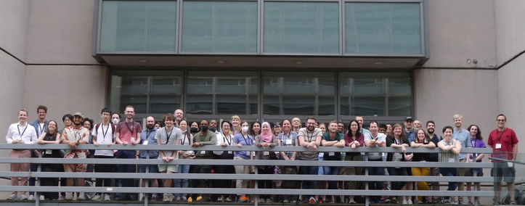


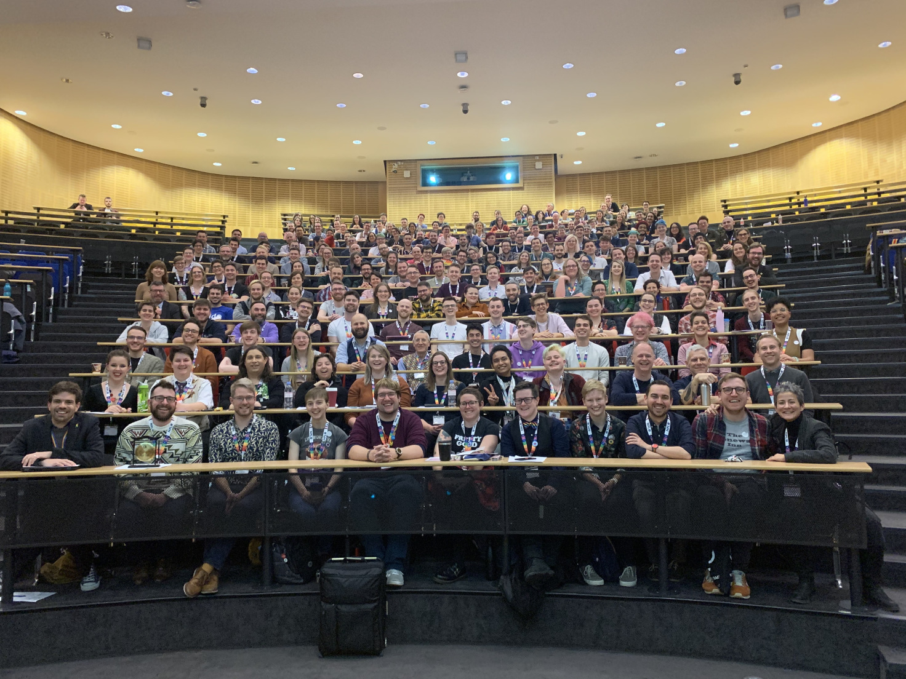
Previous
Activities

Slide 14


Current Activity
Cultivating and Coordinating Positive
Research Culture for LGBTQ+ STEM Researchers
  Mentorship Scheme for Early Career LGBTQ+ Mathematicians / Statisticians
  Joint with Rowland Seymour / Daniel Herring
  Roundtables with professional bodies to outline best practice for LGBTQ+ inclusion
LGBTQ Maths Day – November!

Slide 15
What interventions should we try to do?
What group do you want to create an action for?
What issue do you want to address?
 | UG Students | PGR / Postdoc | Staff | Local community | Research community
Safeguarding
Visibility
Hiring
Platforming
Enabling
Empowering

Slide 16
What interventions should we try to do?
What group do you want to create an action for?
What issue do you want to address?
  Consult the group that you want to help, but do the grunt work to ensure they are not overtaxed.
  Identify the resources needed and secure them
Execute
Use this to build policies after engaging, try them out, monitor if they actually work, evolve them if they don’t, then embed them through practice and making a system to make efficient.

