Slide 1
Staff and student experience of flipped teaching
Mike Robinson
Mathematics
Sheffield Hallam University
m.robinson@shu.ac.uk
Notes:
Some ideas here, but one fundamental question to which I don’t have an answer….
Therefore I’m more interested in the discussion at the end

Slide 2
Background
A module in Dynamical Systems & Fourier Analysis
Very techno-friendly
In previous years:
1 lecture per week (~ 100 students)
Very ‘traditional’ – why?
Attendance reasonably good
1 'tutorial' per week in computer room (~ 25 students) immediately after the lecture
Attendance very poor – why?
Full set of printed notes

Slide 3
Rationale for change
Why change?
Poor attendance especially tutorials and dubious lectures
Student inactivity during tutorials
Maths as a process
demonstrated in lecture but rarely recorded in lecture notes so only seen once
student process often hidden from staff
New opportunities:
video creation + online delivery easier than previously
new teaching space
Notes:
This is of course, “flipped learning”
Could have stopped after changing to combined lecture/tutorial
… but actually here want to focus especially on videos/flipped learning/more interactive classes

Slide 4
What changed?
Cohort split into 2 x 50 students
Each group taught in a single 2 hour class – combined lecture/tutorial
About ½ new material delivered via online video lectures
Preparation: students expected to watch videos before class
Classes much more interactive (peer-peer and peer-tutor)
Reduced printed notes (with gaps)
Notes:
This is of course, “flipped learning”
Could have stopped after changing to combined lecture/tutorial
… but actually here want to focus especially on videos/flipped learning/more interactive classes

Slide 5
Producing Video Lectures
I used screencasts of:
PowerPoint
Tablet PC + stylus (PowerPoint/OneNote)
Other software eg Excel
and also
LiveScribe smartpen
digital camera + pen & paper or mini-whiteboard.
Other ideas
Camera + you + whiteboard
Record current lectures and edit for next year
Get students to make them?
My top tip
Don’t be a perfectionist!
Notes:
I tried all sorts of different approaches (screencast software + powerpoint/onenote/stylus/smartpens/other software/handwritten + camera)
Time consuming to produce (there are ways to reduce this)
My big fear was that students wouldn’t watch them before the classes…
… or that they would hate them

Slide 6
My experience, and what students said
Comparison of video lectures vs traditional
Comparison of new classes vs normal tutorials
Comparison of overall approach vs other modules
Student evaluation taken from
3 anonymous online surveys:
open to all students - conducted week 7 ($n≈50$)
poor attenders only - conducted week 23 ($n=28)$
open to all students - conducted post-exam ($n=21)$
Student online logbooks/progress files (not anonymous)

Slide 8
Student response to video lectures
Notes:
Positive response: logbooks were almost all positive (albeit with suggestions for improvement)
Only negative comment was “they take a long time because I keep having to stop to think”

Slide 9
Student response to video lectures
Which approach helps you learn best?
Video Lecture
Traditional Lecture
How many have you watched?
Key
Strongly prefer new | Slightly prefer new | Slightly prefer old | Strongly prefer old
91% of students had watched at least one video more than once.
(Some had watched the same one more than 5 times.)
62% of students reported re-watching them during revision.
Notes:
First – surprising given what they’ve said

Slide 11
New class compared with old style tutorial
Overwhelmingly, they prefer the new style of class compared with a ‘traditional’ tutorial
Which approach helps you learn best?
New style
“Normal” tutorial
Which kind of class is most interesting/enjoyable?
New style
“Normal” tutorial
Notes:
Asking questions/interactive

Slide 12
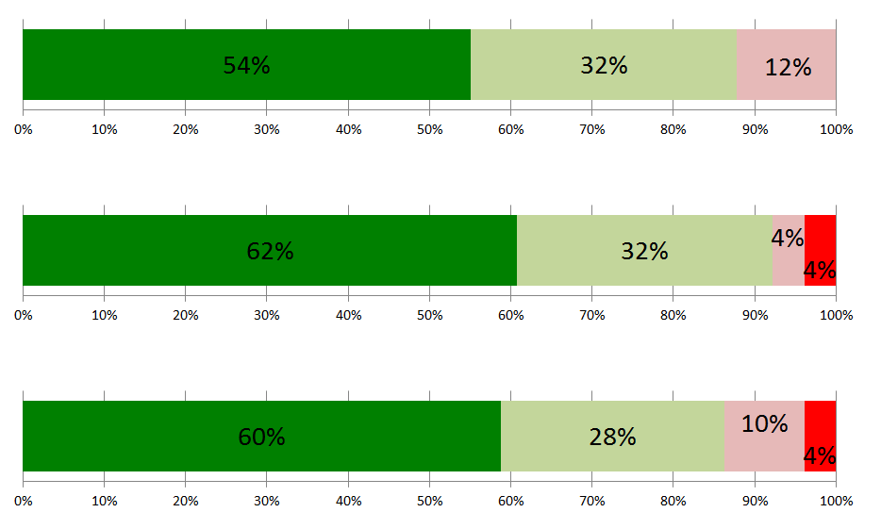
Overall
Which approach helps you to learn the most?
New style
Old style
Which approach is most interesting?
New style
Old style
Overall, which approach do you like the most?
New style
Old style
Notes:
Asking questions/interactive

Slide 13
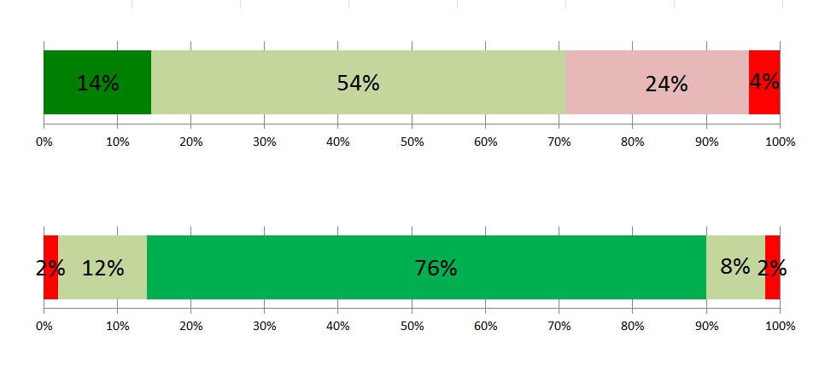
Time on Task
How much time do you spend on this module compared with others?
A lot more
A lot less
Do you think this is…
Far too much
Far too little

Slide 14
Challenges
Benefits
Time
Planning
Video production
Technological
Video production again
Classes harder work
Student resistance
Video lectures have some benefits in their own right, and because…
…much better use of contact time
Room layout was also key
Classes more rewarding for staff
Overall, students like it and report
better learning
time to think
more enjoyable
more time spent working

Slide 15
Did it solve the attendance problem?
In the survey of poor attenders:
2 (out of 28) mentioned the provision of video lectures as the main reason for non attendance when asked an open ended question about it
1 because they preferred to learn using the videos
1 because if they hadn’t watched them, they were lost in class,
9 said not having watched videos was a fairly or very important factor.
2 students cited the style of class as a factor, talking about a sense of being exposed if they didn’t understand when other students did.
Almost all gave other reasons not related to this module delivery.

Slide 16
What next for me?
Redo some videos from earlier in the course in light of experience
Further refinement of in-class activities
Other modules?

